Slide 1
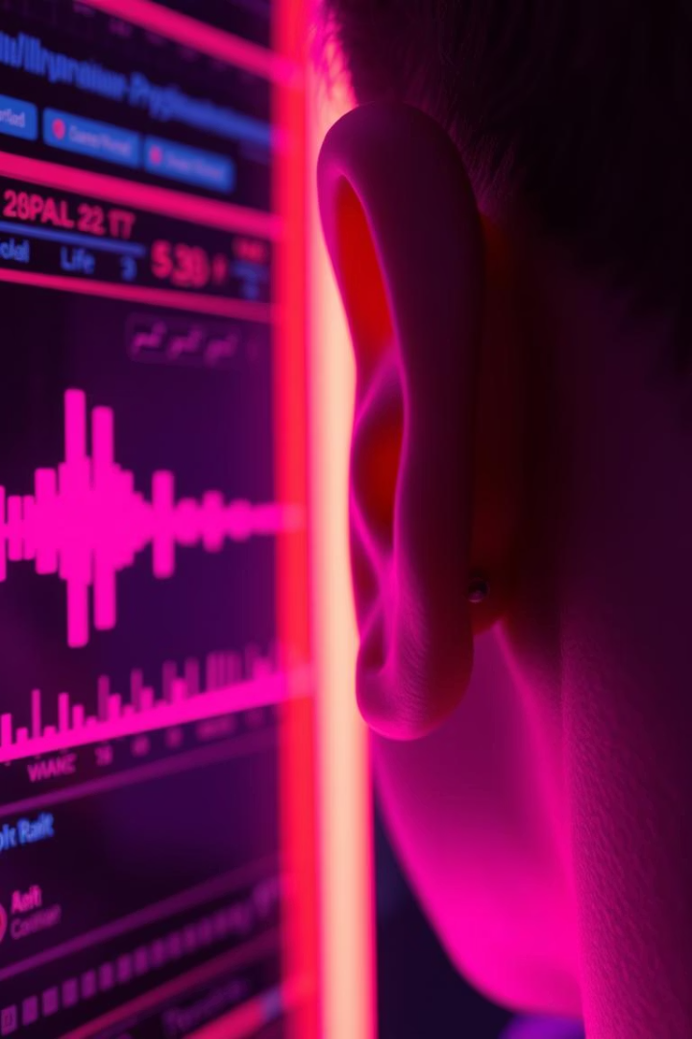
AI vs. Real Voice Classifier: Combating the Dangers of AI-Generated Audio
We use deep learning to distinguish real voices from AI-generated audio.
Our goal: Help protect society from synthetic voice misuse.
Team members: Roshan Nair and Jayaaditya S.
Deep learning Project

Slide 2
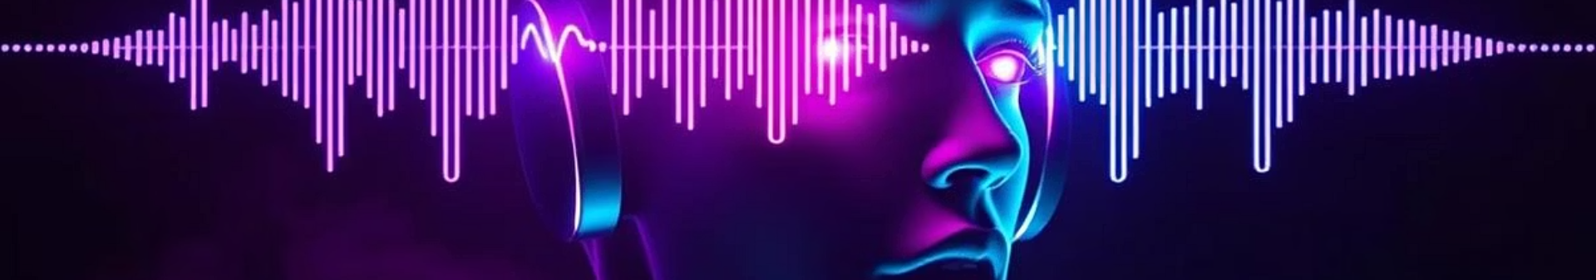
The Dangers of AI-Generated Audio
Misinformation
Identity Theft
Fake audio fuels scams, deepfake media, and propaganda risks.
Impersonation via synthetic voices causes fraud and damage. We have seen so many cases where the voices of celebrities are being mimicked and misuses.
Erosion of Trust
Market Growth
Difficulty distinguishing fake audio undermines media credibility.
AI audio market expected to reach $15B by 2030.

Slide 3
Our Deep Learning Solution
Data Sources
Modeling
Training
Inference
Streamed 4000 samples:2000 real from common_voice_11_0, 2,000 fake from wavefake-audio
Feature extraction using pre-trained Wav2Vec2ForSequenceClassification, fine-tuned for binary classification.
Neural network classifier to predict AI vs Real
Supports any audio format via pydub and torchaudio.

Slide 4
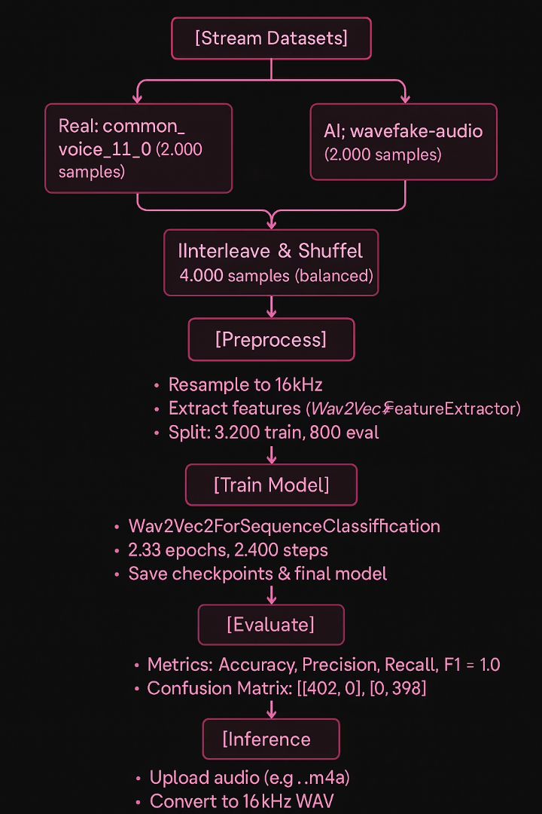




Classifier Workflow Explained
Data Loading and interleaving
Load and preprocess both real and AI audio samples.
Combine real and AI audio into a single dataset of 4,000 samples using interleave_datasets.
Shuffle with a buffer size of 500 to ensure randomness.
Feature Extraction
Use Wav2Vec2FeatureExtractor (from transformers) to convert raw audio waveforms into input features.
Parameters: Sampling rate = 16kHz, padding to max length, return attention mask.
Model initialisation
Model: facebook/wav2vec2-base (pretrained, 94M parameters) with Wav2Vec2ForSequenceClassification head.
Configuration:
Binary classification (2 labels: real, AI).
Output: Logits for each class, converted to probabilities via softmax.
Training
Batch size: 4 (per device, T4 GPU).
Learning rate: 1e-5.
Epochs: 2.33 (2,400 steps total).
Optimizer: AdamW (default in transformers).
Save checkpoints in wav2vec2-audio-clf directory.
Limit to 2 checkpoints to manage disk (~380MB per checkpoint, ~760MB total).

Slide 5

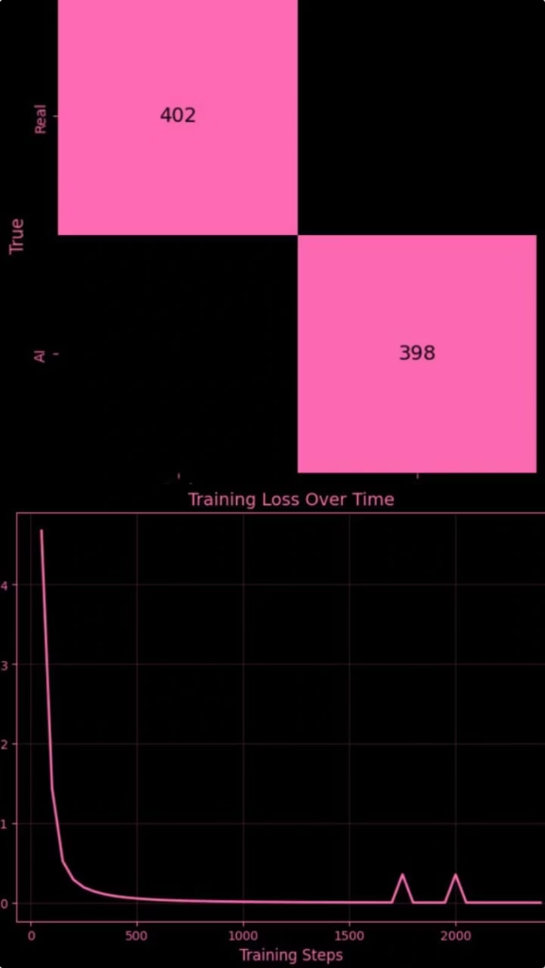


Results and achievements
100
100
Evaluation Metrics:
Confusion Matrix:
Accuracy: 1.0, Precision: 1.0, Recall: 1.0, F1: 1.0 (eval set, 800 samples).
[[402, 0], [0, 398]] (no errors on eval set).
0.0006
Training Loss:
Decreased from 0.4675 (step 50) to 0.0006 (step 2,400).

Slide 6
Real-World Testing and Limitations
Real audio
AI generated audio
Deepfake detection
Limitations
The model is able to perfectly classify all real audio, both in the test sets and real time data
The model is able to also classify AI generated audio if the audio is same as set preset voices generally used for AI audio generation
The model fails to detect any deepfake audio as the personification makes the model classify it as real audio
The model has limitations of detecting only the preset voices of AI generated audio

Slide 7
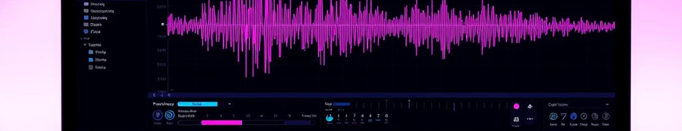

Improvements and changes
75
4000
100
Computation
Robustness
Well trained model
Solved disk space issue via streaming (75 GB saved).
Scaled dataset to 4,000 samples, improving robustness. As opposed to 200 samples in our first presentation
Achieved perfect eval performance (accuracy = 1.0).

Slide 8
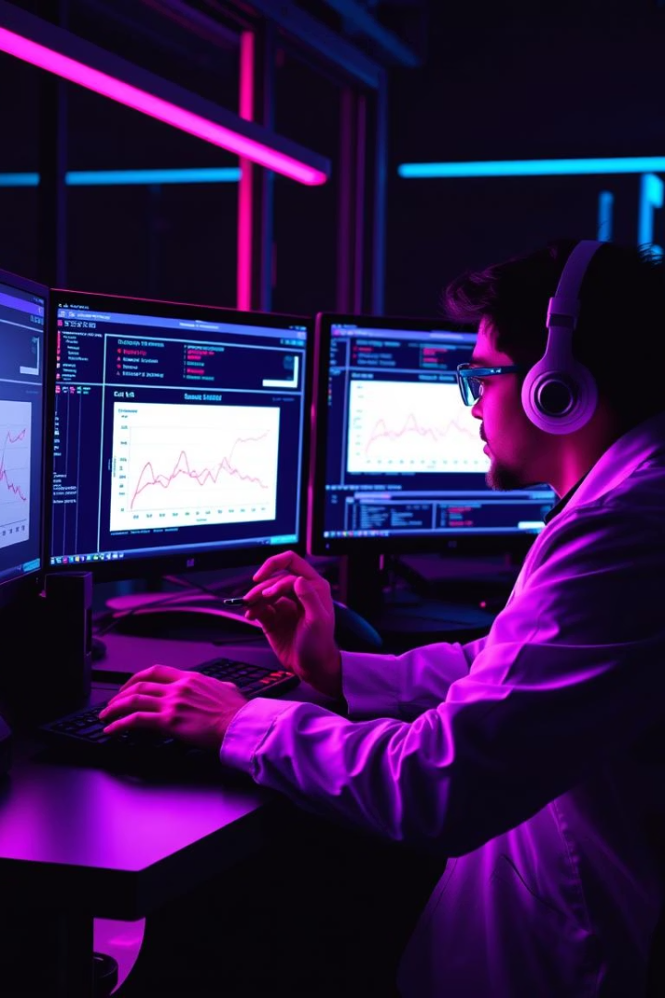
Improvement plan
Increase Dataset Diversity:
Add AI audio from Bark, ElevenLabs, and newer models to training set.
Use data augmentation (Noise, pitch shift) to improve robustness.
Regularization:
Apply dropout, weight decay, or early stopping to reduce overfitting.
Advanced Models:
Explore Wav2Vec2-large or HuBERT for better feature extraction.
Cross-Dataset Evaluation:
Test on external datasets (e.g., ASVspoof, FakeAVCeleb) to measure generalization.

Slide 9

Limitation and Reasoning
Dataset Mismatch:
Overfitting:
The wavefake-audio dataset may not include audio generated by the same model
Perfect eval metrics (accuracy = 1.0) suggest the model may have overfit to the train/eval split, which is drawn from the same interleaved dataset.
Wavefake-audio contains diverse AI audio, but the model may not generalize to the specific characteristics of the test audio.
Feature Extraction Limitations
Insufficient Training Data:
Wav2Vec2FeatureExtractor may not capture subtle differences between real and advanced AI audio (e.g., high-quality ElevenLabs samples).
While 4,000 samples is an improvement, it’s still small compared to the complexity of distinguishing real vs. AI audio across diverse sources.

Slide 10
Improvements and progress
Larger Sample Size
Expand training with more diverse real and AI voice samples. 100 samples each which resulted in longer runtimes
Advanced Models
Experiment with fine-tuning Wav2Vec2 and bigger transformers. Gave us perfect accuracy on test data
Uploading User Audio
Developed another algorithm which allows us to upload audios locally and it will automatically change the format and size to that required for the model, we had to learn to use new libraries and resources
Real-Time Detection
The model is currently able to identify the real audios correctly and is also able to classify the AI generated audios correctly, our limitation is when we face AI audio with different sound profiles and deepfakes.

Slide 11
Improvement-Presentation-1
Increase dataset size:
Trained 200 samples as opposed to 100 samples
Normalization:
Added normalization
Cross checking Models:
Checked if the issue was with the model or with the data availability

Slide 12
Improvement-Presentation-2
Changed dataset:
Chose a more AI specific data instead of x-vector and trained 4000 samples, 2000 from real and 2000 from AI
Streamed data:
We chose to stream the data onto our model instead of downloading it as it was taking up all the available disk space
Used hugging face tokens:
Once we checked if the data could be streamed, we used hugging-face tokens in order to stream the data

Slide 13
Final presentation
Improve dataset:
Plan to make the dataset a combination of (Real, AI generated, Deepfake) audios.
Model improvisation:
As the model was struggling to classify Deepfakes and non recognized voices, we are planning to make the model multi classification so it can classify all types of audio correctly
Use much more capable computers:
Once we develop the model, we will need to use a computer with far more GPU in order to incorporate the vast data size and model complexity.

